Slide 1
Design and Analysis of Algorithms
Lecture 12
Instructor: Mehak Riaz Khan
Email: Mehak.riaz@kiet.edu.pk

Slide 2
Dynamic programming
One of the most important algorithm tools!
Very common interview question
Method for solving problems where optimal solutions can be defined in terms of optimal solutions to sub-problems
AND
the sub-problems are overlapping

Slide 3
Dynamic Programming
Dynamic Programming is an algorithm design technique for optimization problems: often minimizing or maximizing.
Like divide and conquer, DP solves problems by combining solutions to subproblems.
Unlike divide and conquer, subproblems are not independent.
Subproblems may share subsubproblems,
However, solution to one subproblem may not affect the solutions to other subproblems of the same problem.
DP reduces computation by
Solving subproblems in a bottom-up fashion.
Storing solution to a subproblem the first time it is solved.
Looking up the solution when subproblem is encountered again

Slide 4
Dynamic programming
It is used, when the solution can be recursively described in terms of solutions to subproblems
Three main characteristics:
Optimal substructure
Overlapping subproblems
Memoization

Slide 5
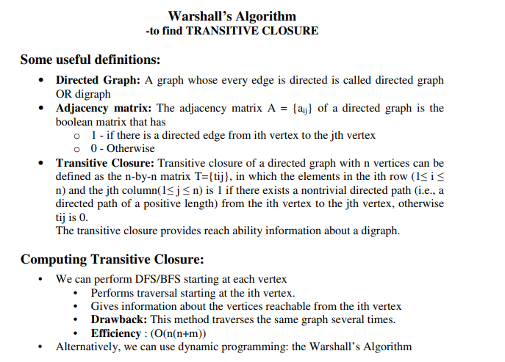

Slide 6
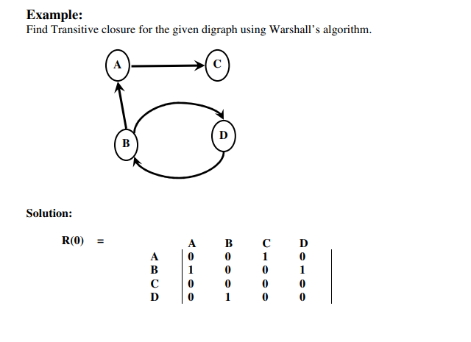

Slide 7
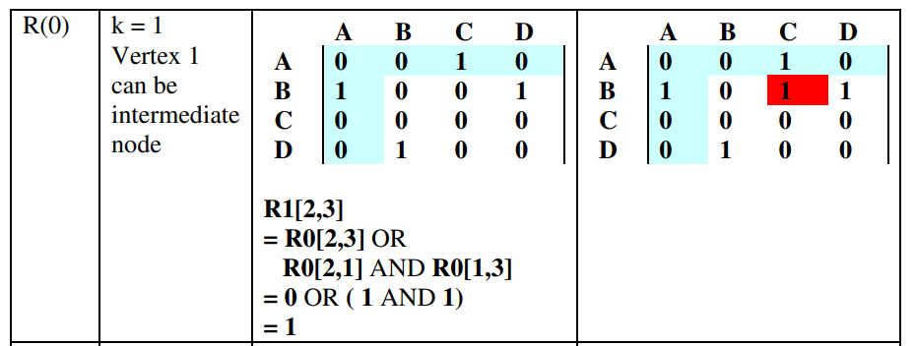
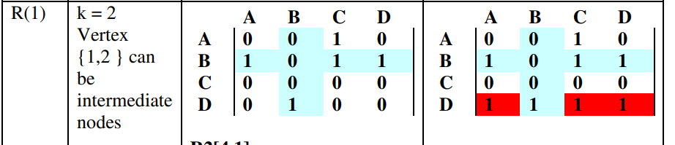

Slide 8
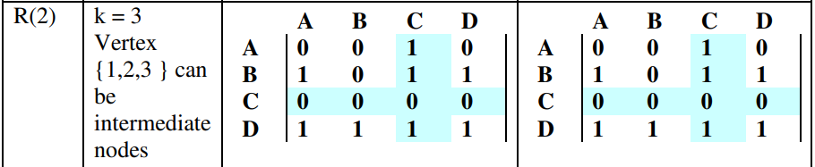
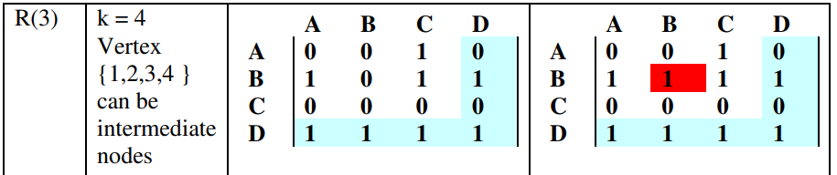
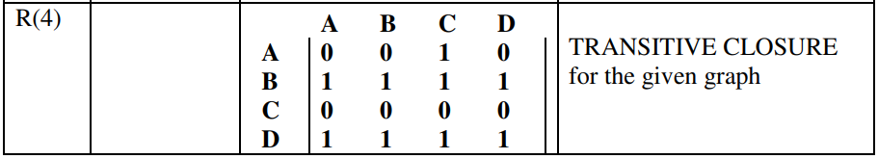

Slide 9
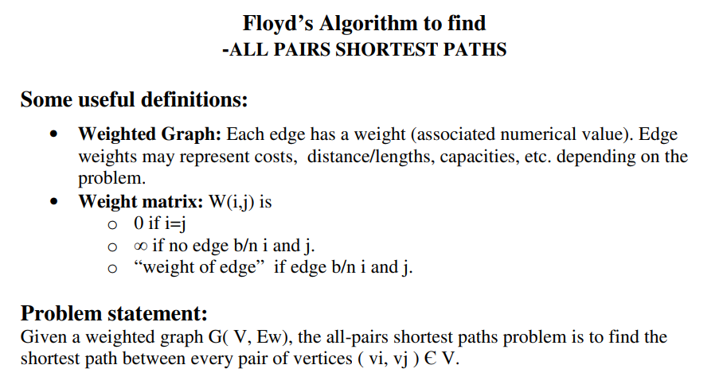

Slide 10
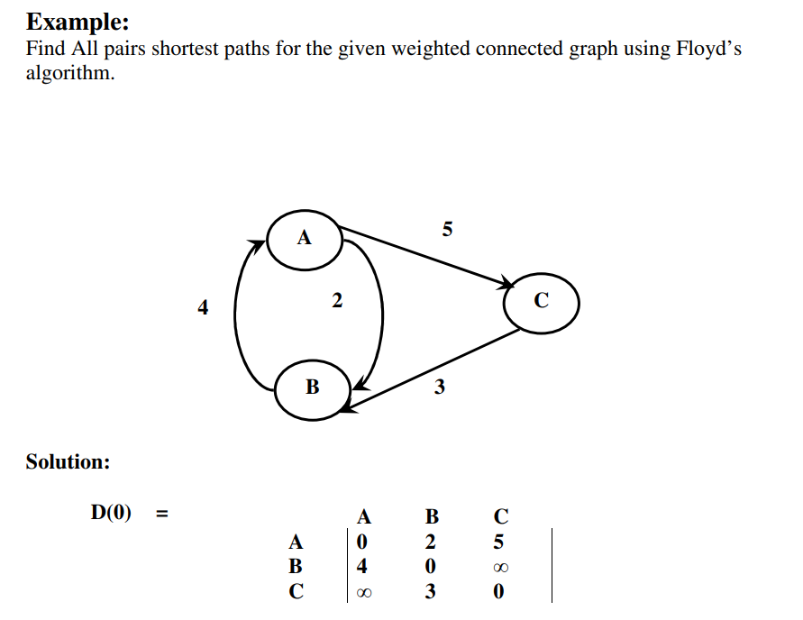

Slide 11
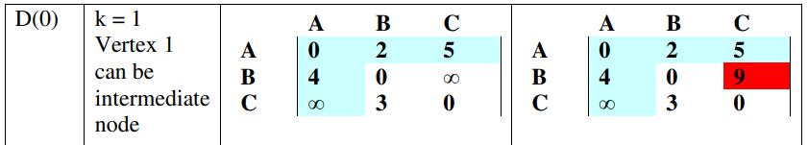
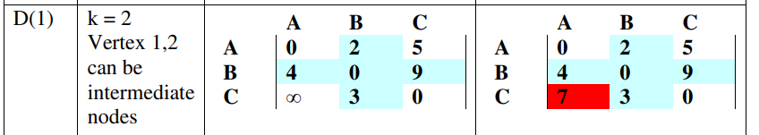
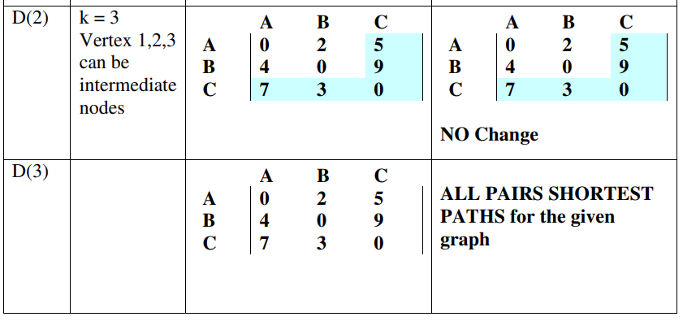

Slide 12
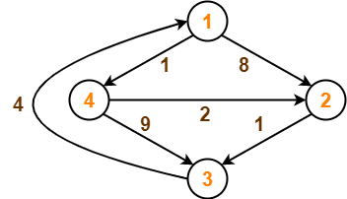

Slide 13
